Slide 1

Syntactic & statistical parsing

Slide 2
Syntactic & statistical Parsing
What is Syntactic parsing,
Ambiguity,
  Attachment Ambiguity,
  Coordination Ambiguity.
CKY Parsing
  Conversion to Chomsky Normal Form,
  CKY Recognition.
  CKY Parsing
  CKY in Practice
Probabilistic Context-Free Grammars,
  PCFGs for Language Modeling,
  Probabilistic CKY Parsing of PCFGs,
  Problems with PCFGs,
Probabilistic CCG Parsing
  Ambiguity in CCG
  Managing ambiguity in CCG
Code Implementations
@Copyrights: Natural Language Processing (NLP) syntactic & statistical parsing (Group no # 8)

Slide 3
Syntactic Parsing (Constituency)
It refers to the breaking down of a text or sentences into its constituents.
Composed of:
Terminals(words)
Non-terminals(phrases/sentences)
Parse trees are used in grammar checking while word processing.
@Copyrights: Natural Language Processing (NLP) syntactic & statistical parsing (Group no # 8)

Slide 4
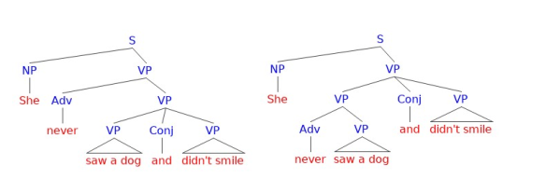
Ambiguity
Structural ambiguity : It is similar to the grammatical phrase structuring.
It occurs when a sentence has a grammar that can be parsed more than once for e.g.
@Copyrights: Natural Language Processing (NLP) syntactic & statistical parsing (Group no # 8)

Slide 5
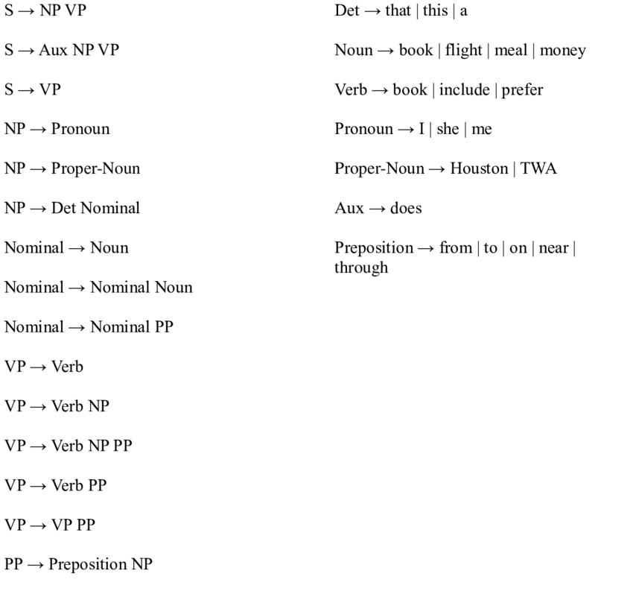
The two types of ambiguity are:
Attachment ambiguity: Constituent or a part of a sentence that can be attached to a parse tree multiple times.
Coordination ambiguity: Conjunctions are used to join two different phrases. e.g. the thief shot the jeweler and the cop panicked.
@Copyrights: Natural Language Processing (NLP) syntactic & statistical parsing (Group no # 8)

Slide 6
CKY Parsing or Cocke-Kasami-Younger algorithm
Handles syntactic disambiguation with the help of dynamic programming.
Chomsky normal form
At the beginning of the CKY algorithm we need to convert the CFGs to CNF.
Unit productions are formed when there is a single non terminal towards the right.
S → Aux NP VP
S → XI VP
XI → Aux NP
@Copyrights: Natural Language Processing (NLP) syntactic & statistical parsing (Group no # 8)

Slide 7
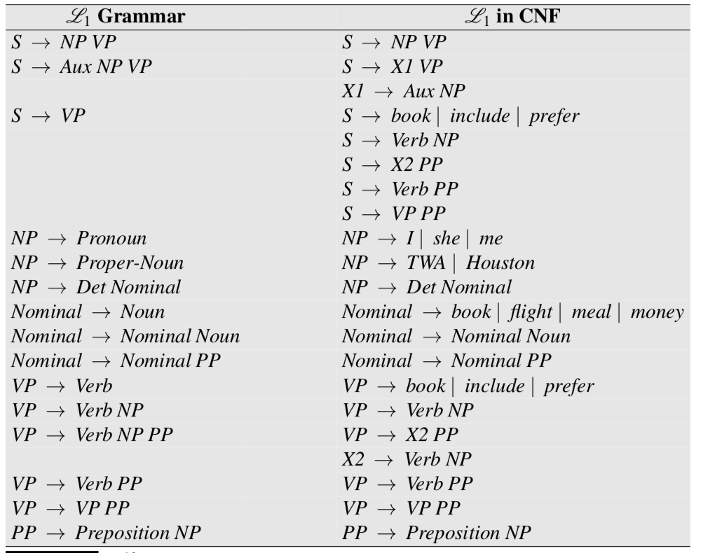
Copying all the conforming rules to a new grammar.
Conversion of terminals to non-terminals.
Conversion of unit products.
All the new rules are made binary and added to new grammar.
@Copyrights: Natural Language Processing (NLP) syntactic & statistical parsing (Group no # 8)

Slide 8
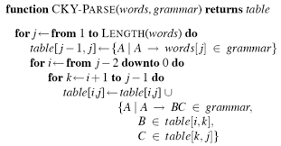
CKY recognition
Parse trees will have two daughters.
Cells [i,j] contains non-terminals which represent the constituents. The indexing begins with 0.
Each constituent is represented by [i,j] which are entries.
K is an input position that should be there where there is a splitting of i<k<j.
[i,k] must lie to the left of the entry of [i,j] and [k,j] must be beneath it along column j.
@Copyrights: Natural Language Processing (NLP) syntactic & statistical parsing (Group no # 8)

Slide 9
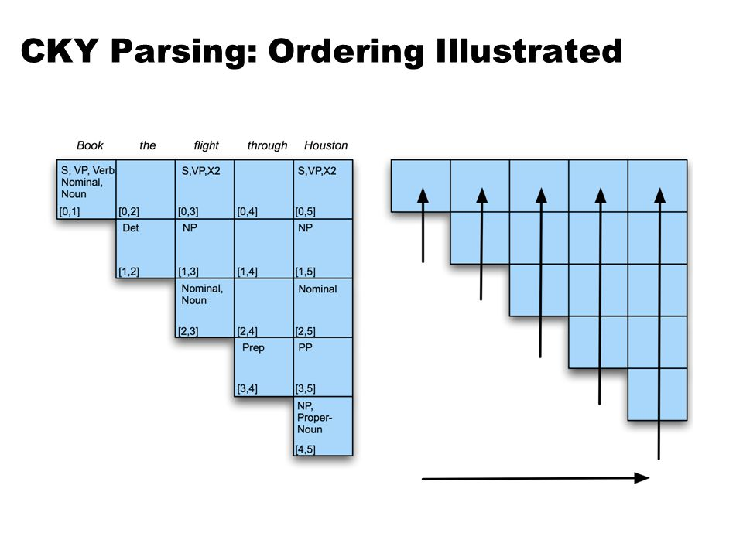
The super diagonal row contains input of the part of speech words.
The subsequent diagonals contain the constituents.
The bottom up filling approach is used.
Filling each column from the left towards the right would mean the processing of each word at a time.
@Copyrights: Natural Language Processing (NLP) syntactic & statistical parsing (Group no # 8)

Slide 10
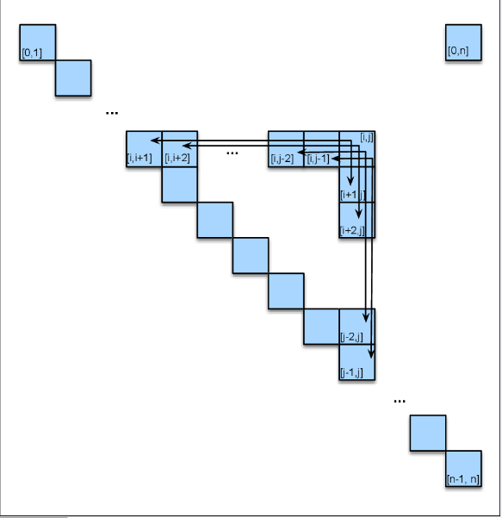
The algorithm tries to combine the constituents of two cells so that they can be permitted by a single rule in grammar and thus the non-terminal is on its left side. The rules used are:
VP → Verb NP PP
VP → X2 PP
The CNF conversion does not create any problems but it can complicate any syntax to semantic analysis.
@Copyrights: Natural Language Processing (NLP) syntactic & statistical parsing (Group no # 8)

Slide 11
Statistical Constituency Parsing
It is possible to build probabilistic parsers consisting of syntatic knowledge.
PFGCs or probabilistic context-free grammar which is an enhancement of CFG.
A probability is assigned to each rule.
These are trained on treebank grammars.
Non-terminals are made more specific or more general.
Also known as Stochastic context-free grammar SCFG.
Consists of N= non-terminal symbols, ∑=terminal symbols, R=rules or productions A͢͢͢͢→β[p], β=string of symbols (∑UN)*, and p is a number between 0 and 1 P(β|A) and S= start symbol.
R is augmented with a conditional probability:
A→β[p]
P→(A→β)
P→(A→β|A)
P(RHS|LHS)
ΣP(A→β)
ᵝ
@Copyrights: Natural Language Processing (NLP) syntactic & statistical parsing (Group no # 8)

Slide 12
Probabilistic CKY Parsing PCFGs
The probabilistic CKY concludes that the PCFG is in the Chomsky normal form.
Indices are assumed between each word.
These are considered and each constituent in the CKY parse tree is encoded in a two dimensional matrix.
The upper triangular portion of the matrix is used (n+1)x(n+1) matrix.
Each cell table [i,j] contains a list of constituents that spans a sequence of words from i to j.
The sentence “ the flight includes a meal” is connected to chomsky normal form in order for the CKY algorithm to work on it and to handle the rule properties.
Separate counts are needed for each constituents in the PCGs using the Inside-out algorithm.
@Copyrights: Natural Language Processing (NLP) syntactic & statistical parsing (Group no # 8)

Slide 13
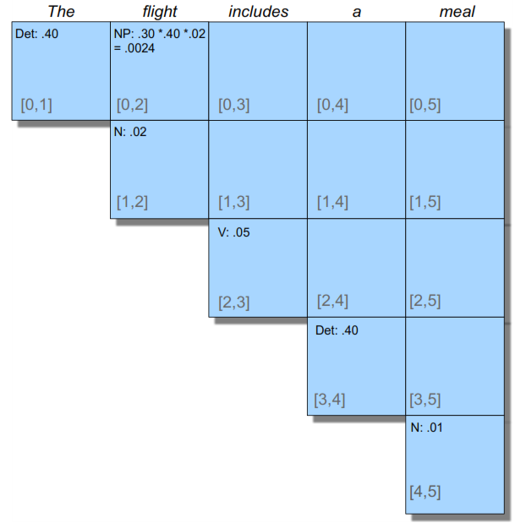
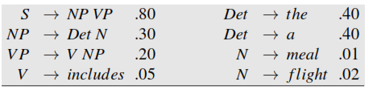
Probabilistic CKY Parsing PCFGs
@Copyrights: Natural Language Processing (NLP) syntactic & statistical parsing (Group no # 8)

Slide 14
Problems with PCFGs
Poor independence assumptions: CFG rules impose an independence assumption on probabilities that leads to poor modeling of structural dependencies across the parse tree.
Lack of lexical conditioning: CFG rules don’t model syntactic facts about speciﬁc words, leading to problems with sub categorization ambiguities, preposition attachment, and coordinate structure ambiguities.
@Copyrights: Natural Language Processing (NLP) syntactic & statistical parsing (Group no # 8)

Slide 15

Probabilistic CCG Parsing
Lexicalized grammar frameworks such as CCG pose problems for which the phrase based methods we’ve been discussing are not particularly well-suited.
@Copyrights: Natural Language Processing (NLP) syntactic & statistical parsing (Group no # 8)

Slide 16
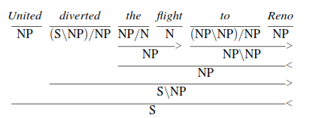

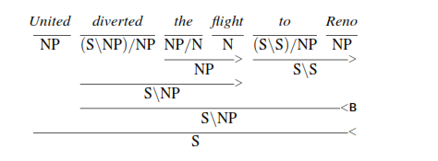
Ambiguity in CCG
@Copyrights: Natural Language Processing (NLP) syntactic & statistical parsing (Group no # 8)

Slide 17
Managing ambiguity
Managing ambiguity is the key factor to successful CCG parsing.
The problems due to ambiguity are caused due to large numbers of lexical complex categories.
The source of ambiguity is found from the lexicon not from the grammar.
To Reno modifies the flight and prepositions are added.
The right side is assigned traditional prepositions and modification is done by to Reno.
The choice of lexical categories is the primary problem to be considered in CCG parsing.
@Copyrights: Natural Language Processing (NLP) syntactic & statistical parsing (Group no # 8)

Slide 18
Implementation

Slide 19
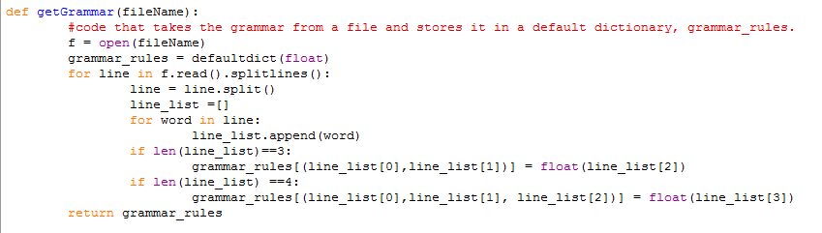
Python-code
We are using Anaconda-prompt to run this code files:
First we run convert our grammar in CNF form in .txt file.
Second write different sentences.
Third applying CKY parsing .
@Copyrights: Natural Language Processing (NLP) syntactic & statistical parsing (Group no # 8)

Slide 20
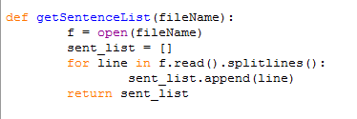
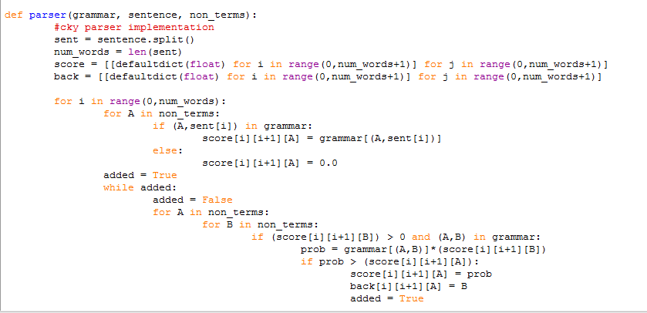
Second write different sentences
Third applying CKY parsing .

Slide 21
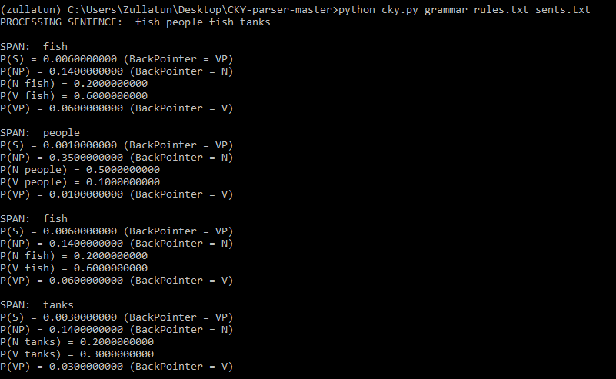
Code Output

Slide 22
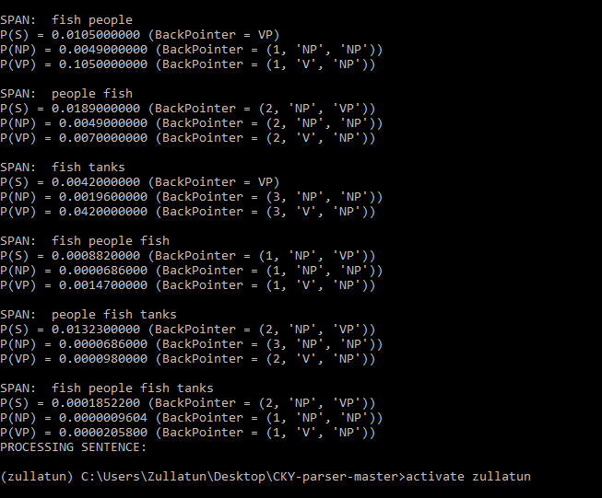

Slide 23
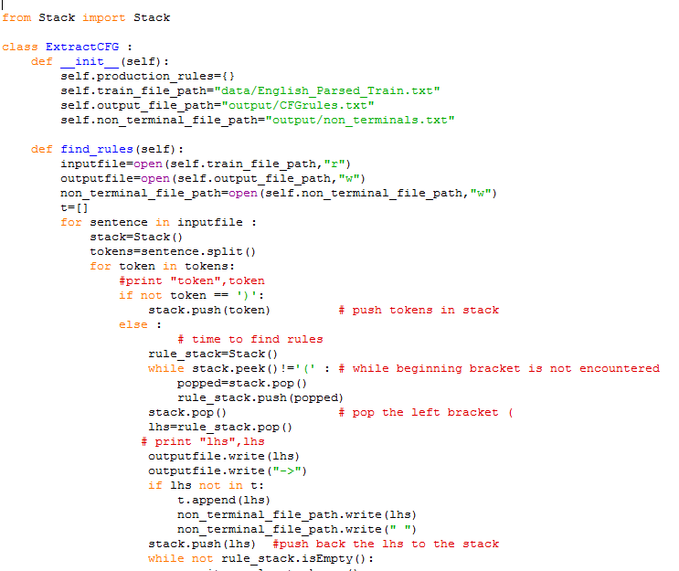
Python-code
Python extractCFG.py ....finds all rules from training file parse trees(data/English_Parsed_Train.txt)
First we have to run this file to set environment for CFG
@Copyrights: Natural Language Processing (NLP) syntactic & statistical parsing (Group no # 8)

Slide 24
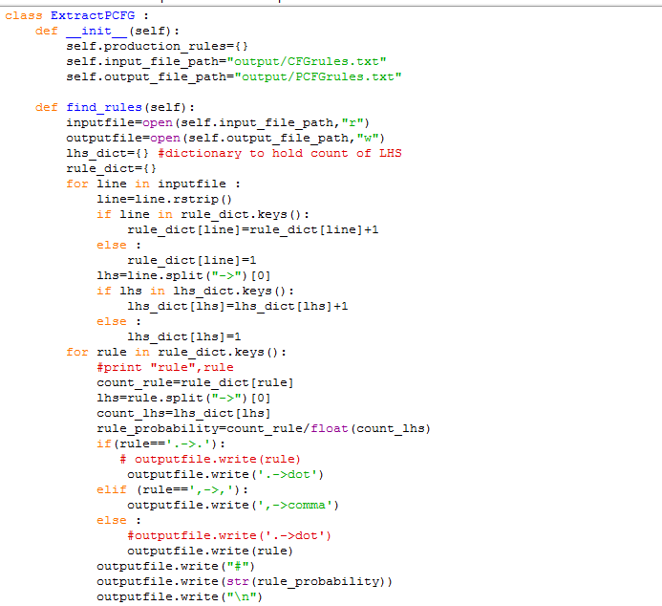
Python extractPCFg.py ....takes output of step 1(output/CFGrules.txt),gives probabilities to rules
Second we do PCFG assigning probabilities and making new rules

Slide 25
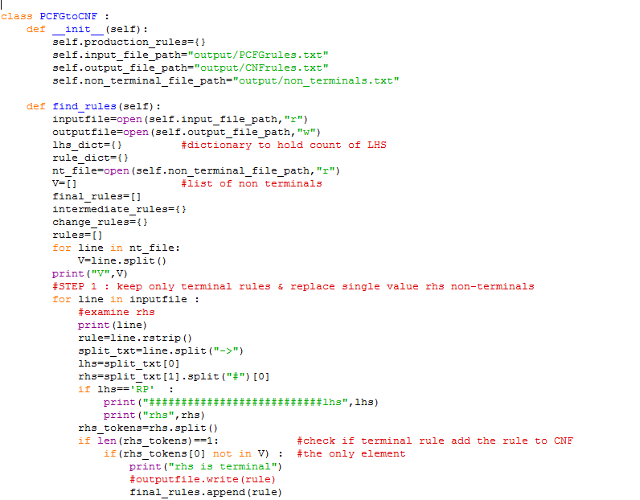
Python findCNF.py ....takes output of step 2(output/PCFGrules.txt),gives Chomsky Normal form production rules

Slide 26
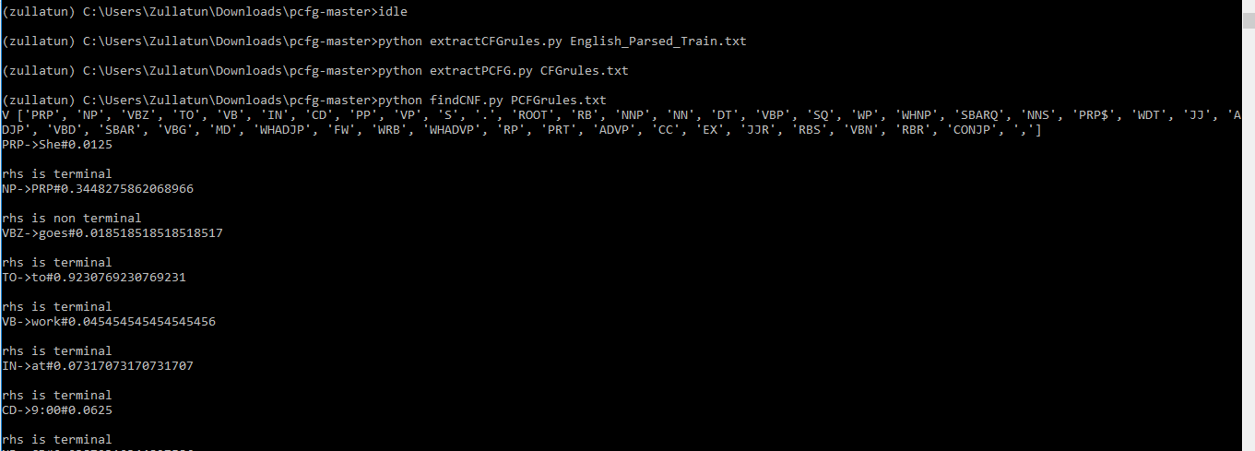
Code Output

Slide 27
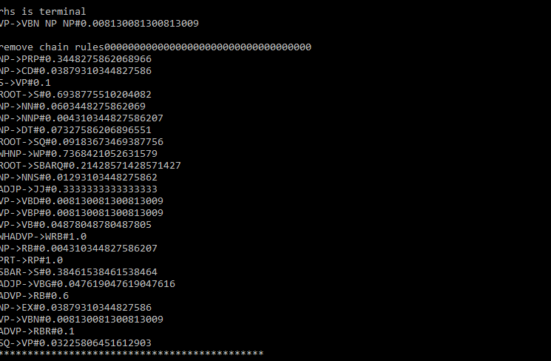
Removing old grammar rules Making new rules for CFG by PCFG

Slide 28
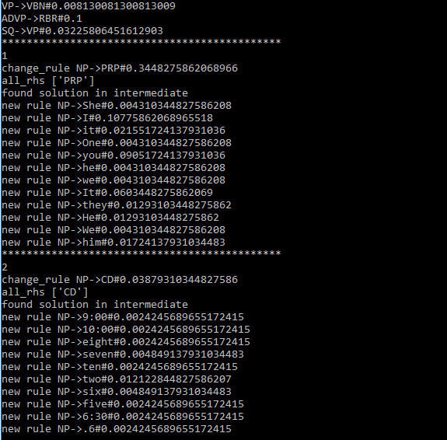

Slide 29
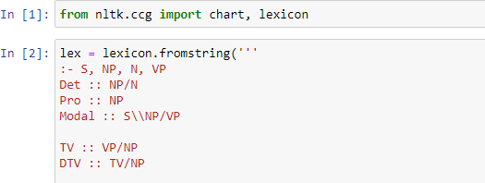
Python-code(CCG Parsing)
We use built-in library NLTK with python 3.x in jupyter notebook.
We show some basic and small functions which can easily adjusted in slide

Slide 30
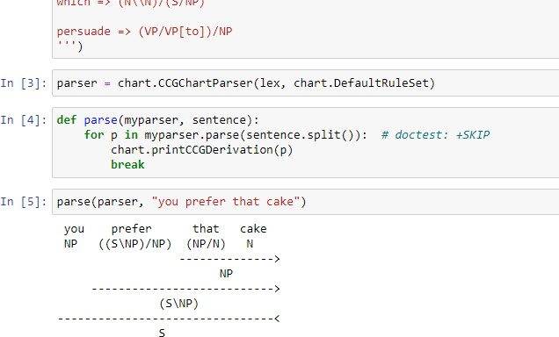
Sentence 1 for CCG parsing

